Slide 1

iOS Dev Camp #3 Week 4 Intro
Edward Chiang
2014.10.27 - 2014.10.31

Slide 2
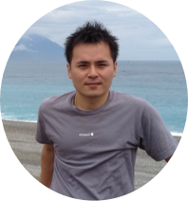

講師介紹
Edward Chiang
Soleil Software Studio, Inc.
日傑資訊有限公司 負責人
前愛料理 Mobile Team 主管
開發過知名 App：
iCook for iPhone
iCook for iPad
Mr. Plurk for iPhone
LovingHeart for iPhone
21 世紀不動產 for iPhone

Slide 3

Soleil Software Studio, Inc.
顧問
開發
設計
課程

Slide 4
This Week
Foundation Framework
Value
String
Collections
Advance

Slide 5
This Week
Attributed String
NSAttributedString
UIColor
UIFount

Slide 6
Daily Homework
Print all value
Print strings
Print object to console
Write, test and print
Define color and font

Slide 7
~ END ~
http://www.alphacamp.tw

